Slide 1
What is Keyword Spotting?

Slide 2
Keyword Spotting v.
General Speech Recognition
Keyword spotting is one of the most successful examples of TinyML
Low-power, continuous, on-device
Common Voice SWTS expands keyword spotting to more languages

Slide 3
Keyword Spotting v.
General Speech Recognition
Keyword spotting is one of the most successful examples of TinyML
Low-power, continuous, on-device
Common Voice SWTS expands keyword spotting to more languages
General ASR still requires larger, power-hungry models
But it can run on mobile devices (offline dictation on smartphones)

Slide 4






Keyword Spotting (KWS)
Speech To Text (STT)
Natural Language
Processing (NLP)
Speech
STT
Text
NLP
Request
Skill
Response
Speech
TTS
...
Text To Speech (TTS)
Notes:
https://pixabay.com/vectors/icon-infographic-key-lock-mechanics-1296022/
https://pixabay.com/vectors/mic-microphone-icon-vector-images-1418319/
https://pixabay.com/vectors/acoustic-audio-balance-burn-1294298/
https://pixabay.com/vectors/weather-sun-sunshine-clouds-cloudy-160922/
https://pixabay.com/vectors/note-sound-music-melody-concert-24074/
https://pixabay.com/illustrations/cooking-utensils-pots-and-pans-5761063/

Slide 5

Notes:
ALT [note for dhilan, UNUSED]: https://pixabay.com/photos/voice-control-voice-commands-2598422/

Slide 6
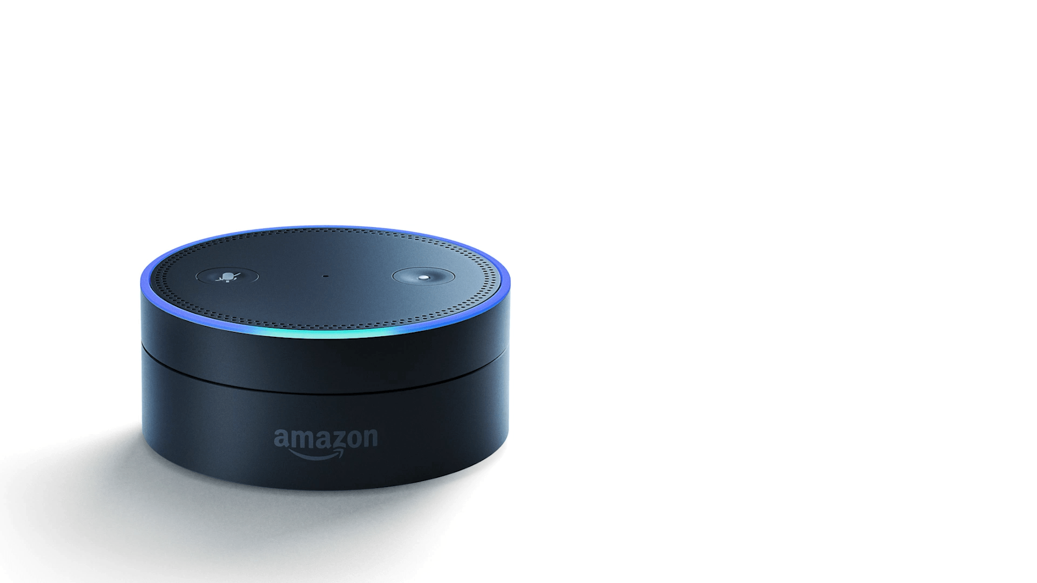
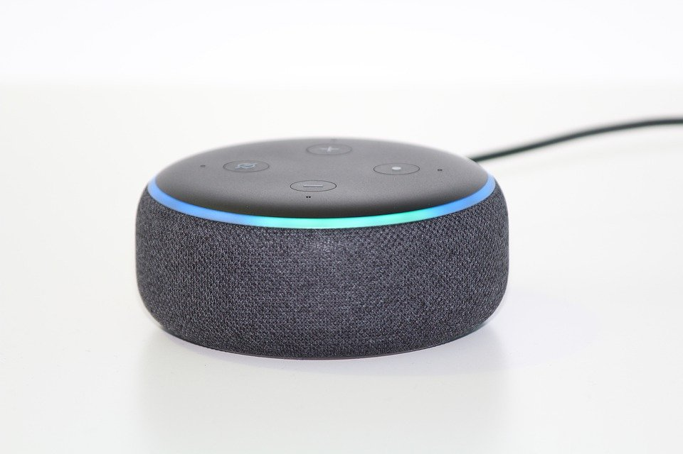
Notes:
ALT [note for dhilan, UNUSED]: https://pixabay.com/photos/alexa-echo-smart-home-box-4758340/

Slide 7

Notes:
https://pixabay.com/ru/illustrations/%D1%83%D0%BC%D0%BD%D1%8B%D0%B9-%D0%B4%D0%BE%D0%BC-%D0%B4%D0%BE%D0%BC-%D1%82%D0%B5%D1%85%D0%BD%D0%BE%D0%BB%D0%BE%D0%B3%D0%B8%D0%B8-2005993/

Slide 8
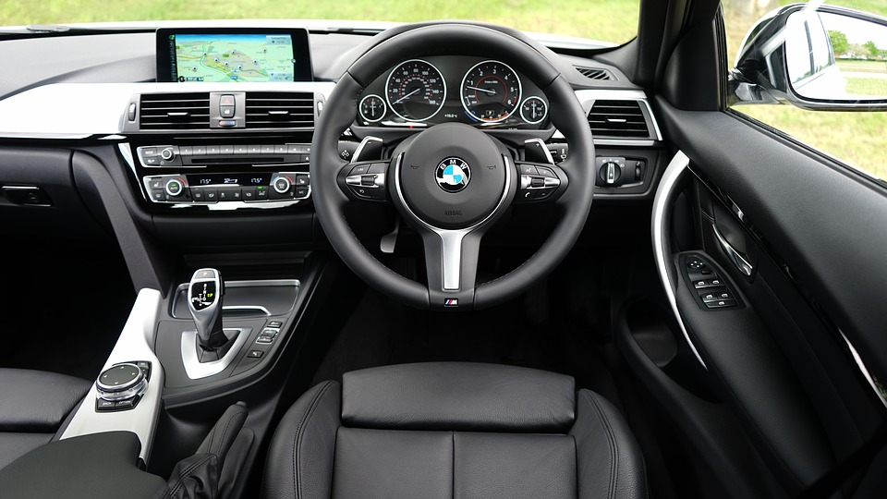
Notes:
https://pixabay.com/ru/photos/%D0%B0%D0%B2%D1%82%D0%BE%D0%BC%D0%BE%D0%B1%D0%B8%D0%BB%D1%8C-bmw-%D0%B8%D0%BD%D1%82%D0%B5%D1%80%D1%8C%D0%B5%D1%80-%D0%B0%D0%B2%D1%82%D0%BE%D0%BC%D0%BE%D0%B1%D0%B8%D0%BB%D1%8F-1834279/

Slide 9
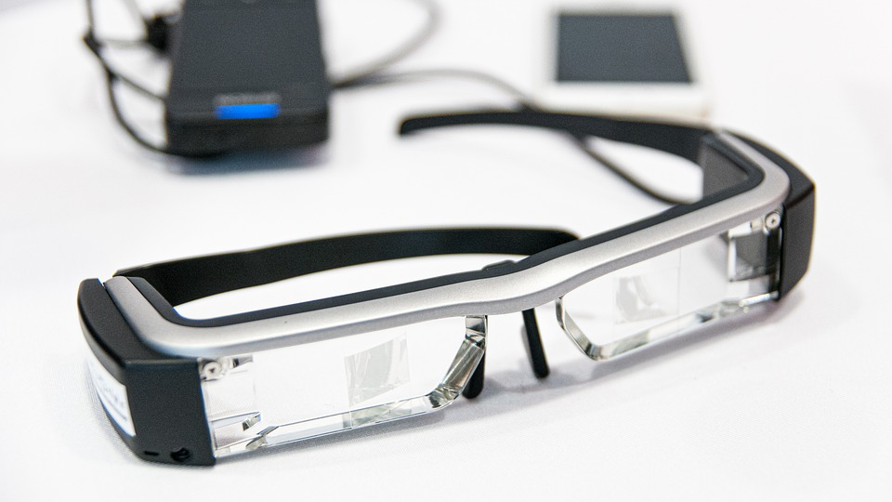
Notes:
https://pixabay.com/photos/google-glasses-high-tech-modern-4294418/

Slide 10

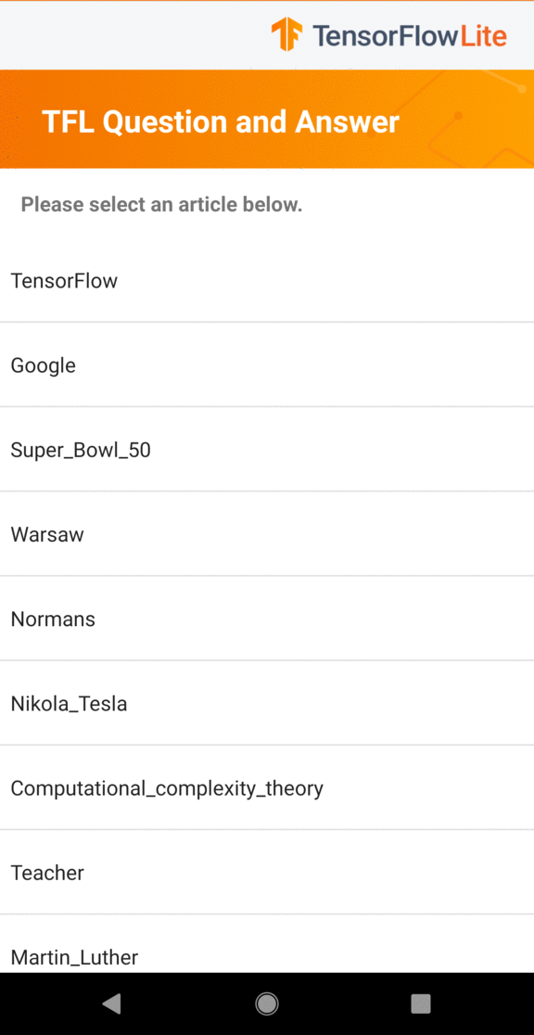

What else can TinyML do with audio data?
Now Playing
by Google
New Rules by Dua Lipa
Notes:
Always on music recognition by Google: https://static.googleusercontent.com/media/research.google.com/en//pubs/archive/46522.pdf
Music note: https://thenounproject.com/search/?q=music+note&i=2271177

Slide 11



What are we going to learn?
Collect and Preprocess Data
Design
and Train
Model
Evaluate, Optimize, Convert, Deploy
Make
Inferences
Micro
Challenges with Keyword Spotting
The Keyword Spotting ML Pipeline
Hands-on training of a Keyword Spotting Model
Notes:
Challenges = Cloud+Edge implications for Security, Privacy, Bandwidth, Battery, Latency, Accuracy, Datasets/Personalization -> how this leads to CONSTRAINTS
The Wake Words ML Pipeline = Hands on example drive case study of how to map a TinyML application to the pipeline in light of the previous CONSTRAINTS (pre-processing, model, data, testing etc.)
Hands-on training of a wake words model in Colab! = You’ll train a real TinyML model from scratch to recognize wake words -- and in course 3 we’ll deploy your custom model to your own device!
Bridge: https://thenounproject.com/term/challenge/2484190/
Diagram: by Dhilan (prof-owned)
Colab Logo: by Brian (prof-owned)

Slide 12
What are we going to learn?
Collect and Preprocess Data
Design
and Train
Model
Evaluate, Optimize, Convert, Deploy
Make
Inferences
Micro
Challenges with a Wake Words Application
The Keyword Spotting ML Pipeline
Hands-on training of a wake words model in Colab!
Notes:
Challenges = Cloud+Edge implications for Security, Privacy, Bandwidth, Battery, Latency, Accuracy, Datasets/Personalization -> how this leads to CONSTRAINTS
The Wake Words ML Pipeline = Hands on example drive case study of how to map a TinyML application to the pipeline in light of the previous CONSTRAINTS (pre-processing, model, data, testing etc.)
Hands-on training of a wake words model in Colab! = You’ll train a real TinyML model from scratch to recognize wake words -- and in course 3 we’ll deploy your custom model to your own device!
Bridge: https://thenounproject.com/term/challenge/2484190/
Diagram: by Dhilan (prof-owned)
Colab Logo: by Brian (prof-owned)

Slide 13
What are we going to learn?
Collect and Preprocess Data
Design
and Train
Model
Evaluate, Optimize, Convert, Deploy
Make
Inferences
Micro
Challenges with a Wake Words Application
The Wake Words ML Pipeline
Hands-on training of a Keyword Spotting Model
Notes:
Challenges = Cloud+Edge implications for Security, Privacy, Bandwidth, Battery, Latency, Accuracy, Datasets/Personalization -> how this leads to CONSTRAINTS
The Wake Words ML Pipeline = Hands on example drive case study of how to map a TinyML application to the pipeline in light of the previous CONSTRAINTS (pre-processing, model, data, testing etc.)
Hands-on training of a wake words model in Colab! = You’ll train a real TinyML model from scratch to recognize wake words -- and in course 3 we’ll deploy your custom model to your own device!
Bridge: https://thenounproject.com/term/challenge/2484190/
Diagram: by Dhilan (prof-owned)
Colab Logo: by Brian (prof-owned)

